Slide 1
Power BI

Slide 2
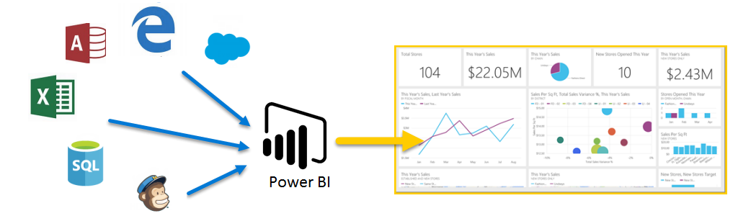
Turn unrelated sources into fancy visuals
Notes:
Power BI is a collection of software services, apps, and connectors that work together to turn your unrelated sources of data into coherent, visually immersive, and interactive insights.

Slide 3
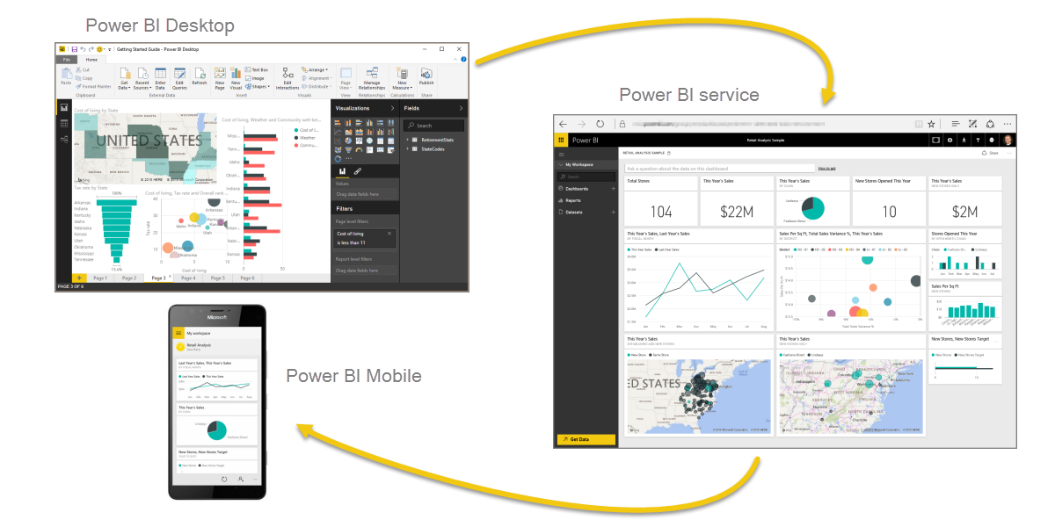
Parts of Power BI
Notes:
Power BI consists of a Windows desktop application called Power BI Desktop, an online SaaS (Software as a Service) service called the Power BI service, and mobile Power BI apps available on mobile devices.

Slide 4
Common Flow
Bring data into Power BI Desktop, and create a report.
Publish to the Power BI service, where you create new visualizations or build dashboards
Share your dashboards with others, especially people who are on the go
View and interact with shared dashboards and reports in Power BI Mobile apps

Slide 5
Building Blocks
Visualizations
Some visual representation of data (chart, graph, map, etc.)
Dataset
Collection of data that Power BI uses to create visuals
Connectors enable pulling in data from different sources
Reports
A collection of visualizations that appear on one or more pages
Dashboards
A collection of visualizations from a single page that you can share with others
Tile
A single visualization found in a report or on a dashboard

Slide 6
Hands On Lab
Install Power BI Desktop
Get temperature and location data using the Azure CosmosDB connector http://bit.ly/cosmos_powerbi
Add a Map visual, showing Average temperature in each location
Add a line chart visual showing Average temperature
Hint: This should look like a sine wave
Add a report level filter to only show data where fit = 1
Optional) Add a report level filter to only show data in the last 2 days (including today)
Add a Multi Row Card showing the temperature and deviceid from rollingAverage
Stretch Goals
Modify the query to only return the columns that your report actually uses (Time, Temperature, Latitude and Longitude)
Modify the query to only show data from the last hour
Explore the available visuals, build something cool

